Slide 1

IBM University Engagement Project Submission
“Exploring the Power of Agentic AI with IBM Granite and LangFlow”

Slide 2

Project Tile – Fitness Buddy
Domain of Project – Healthcare and Fitness
Student Name | Recent Passport Photo | Email ID | Mobile number [WhatsApp]
Samarth Kadam |  | 202401040131@mitaoe.ac.in | 8080126820

Slide 3
Problem Statement :
In today's fast-paced world, maintaining a healthy lifestyle is increasingly
difficult. Existing fitness solutions are expensive, rigid, and impersonal. There is
a critical need for an intelligent, accessible, and personalized virtual fitness
assistant available to everyone — anytime, anywhere.
High Cost of Fitness Guidance - Personal trainers, gym memberships, and nutrition consultations are expensive and inaccessible for most people.
Time Constraints & Rigid Schedules - Traditional fitness programs demand fixed schedules that don't fit busy lifestyles, desk jobs, or family responsibilities.
Lack of Personalization - Generic workout and diet plans ignore individual body stats, goals, dietary preferences, and cultural food habits.
Inconsistent Motivation - Without ongoing support and encouragement, most people abandon their fitness goals within weeks of starting.
No Culturally Relevant Nutrition Guidance - Most fitness apps ignore regional dietary habits. Indian users lack guidance tailored to dal, roti, sabzi, and traditional meal patterns.

Slide 4
Proposed Solution
Fitness Buddy AI is an AI-powered web application built using Python Flask and IBM Watsonx.ai (Granite model). It provides personalized fitness guidance, workout plans, meal recommendations, and health tracking through an interactive chatbot.
Key Features
🤖 AI Fitness Chatbot – Answers fitness and nutrition queries in real time.
🏋️ Personalized Workout Plans – Beginner, Intermediate, Weight Loss, and Yoga plans.
🍛 Indian Meal Plans – Diet plans for Weight Loss, Muscle Gain, and Balanced Fitness.
📊 BMI & Calorie Calculator – Calculates BMI, calorie needs, and ideal weight range.
✅ Habit Tracker – Tracks water intake, sleep, workouts, and daily steps.
💡 Daily Motivation – Provides fitness tips and motivational quotes to keep users consistant.

Slide 5
Technology Used
Technology Purpose
IBM Cloud Lite API key authentication and cloud services
IBM Watsonx.ai AI platform for hosting and accessing Granite models
IBM Granite 4H Small Generates AI-based fitness and nutrition responses
Python Flask Backend development, REST APIs, and session management
IBM Watsonx.ai SDK Connects Flask application with Watsonx.ai
Bootstrap 5 & CSS Responsive, mobile-friendly user interface
JavaScript Chatbot interaction, BMI calculator, workout timer, and habit tracker

Slide 6
Langflow component Used -
Chat Input – Receives user fitness queries.
Data Input (User Profile) – Collects age, height, weight, fitness goal, and diet preference.
Prompt Template – Loads system instructions and AI behavior.
Conversation Memory – Maintains chat history for context-aware responses.
Agent Executor (FitBuddy Agent) – Processes requests and manages workflow.
Tool Node – Executes BMI calculation, workout planning, and meal planning.
IBM Cloud IAM – Authenticates using IBM Cloud API Key.
IBM Watsonx.ai – Connects the application to IBM AI services.
IBM Granite 4H Small – Generates personalized AI fitness responses.
Chat Output – Displays the final response to the user.

Slide 7
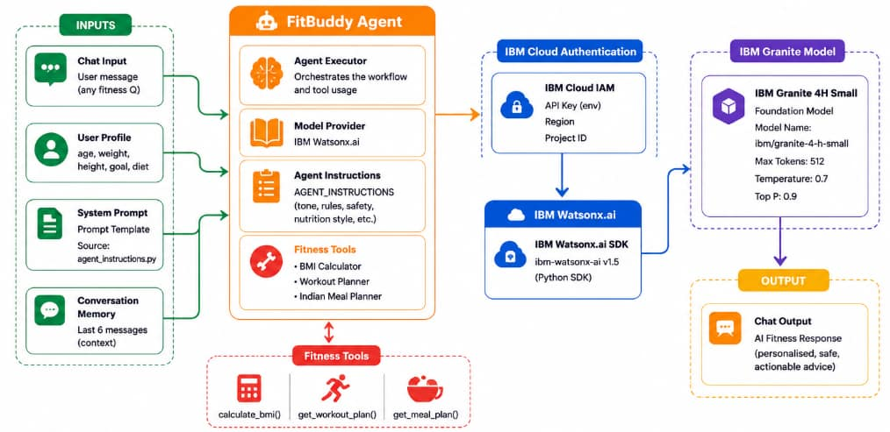
Langflow workflow -

Slide 8
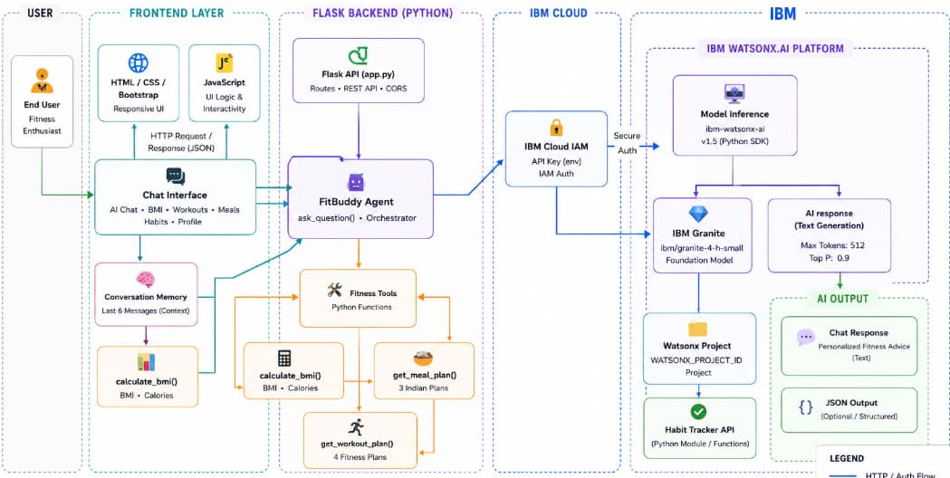
Architecture blueprint

Slide 9
Role of Agentic AI in the solution
Acts as a Personal Fitness Coach – Provides 24/7 personalized fitness and nutrition guidance.
Makes Intelligent Decisions – Analyzes user input and recommends suitable workouts, meal plans, or health tips.
Goal-Oriented Assistance – Tailors advice based on the user's fitness goals, age, BMI, and preferences.
Context-Aware Interaction – Remembers previous conversations to deliver relevant and consistent responses.
Ensures Safe Recommendations – Avoids harmful advice and encourages professional consultation when necessary.
Supports Indian Lifestyle – Suggests culturally relevant Indian diets and fitness practices.

Slide 10
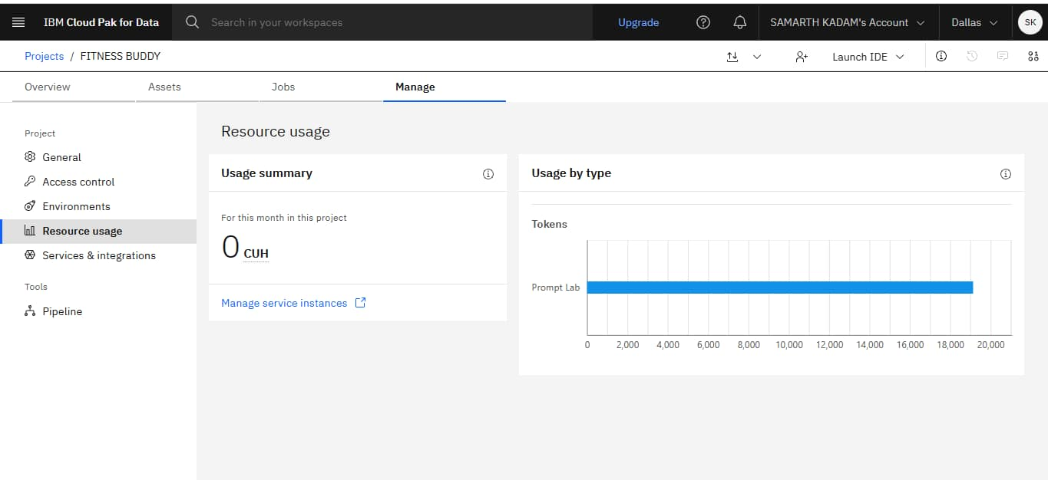
Token Usage
·
·
·

Slide 11
Novelty and Uniqueness
Indian-First Fitness Coach – Provides workout and meal recommendations tailored to Indian diets and lifestyles.
IBM Granite-Powered AI – Uses IBM Watsonx.ai for intelligent, safe, and personalized fitness guidance.
Customizable AI Agent – AI behavior (tone, safety rules, and nutrition style) can be easily modified through configuration.
All-in-One Platform – Combines AI chat, BMI calculator, workout planner, meal planner, and habit tracker in a single web application.
Context-Aware Agentic AI – Remembers previous conversations to deliver personalized and goal-oriented responses.
Safety-First Design – Encourages healthy practices and avoids unsafe fitness recommendations.
No Installation Required – Browser-based application with a responsive interface and dark mode support.

Slide 12
Git Hub Link
https://github.com/Samu7709/Fitness-buddy-Project/tree/main
·
·
·

Slide 13
Future Scope
Mobile Application – Develop Android and iOS versions for easier access.
Wearable Integration – Connect with smartwatches and fitness bands to track real-time health data.
Advanced AI Nutrition – Generate personalized meal plans based on medical conditions and dietary preferences.
Progress Analytics – Provide detailed reports, graphs, and AI-powered fitness insights.
Exercise Demonstrations – Add video tutorials and AI-based posture correction.
Multi-language Support – Support regional languages to reach a wider audience.
Community Features – Introduce fitness challenges, leaderboards, and social sharing for motivation.
Healthcare Integration – Enable secure sharing of health reports with doctors and fitness professionals.
·
·
·

Slide 14

Certificates Earned:

Slide 15
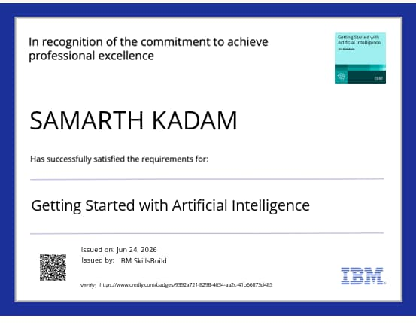
Certificates Earned:

Slide 16
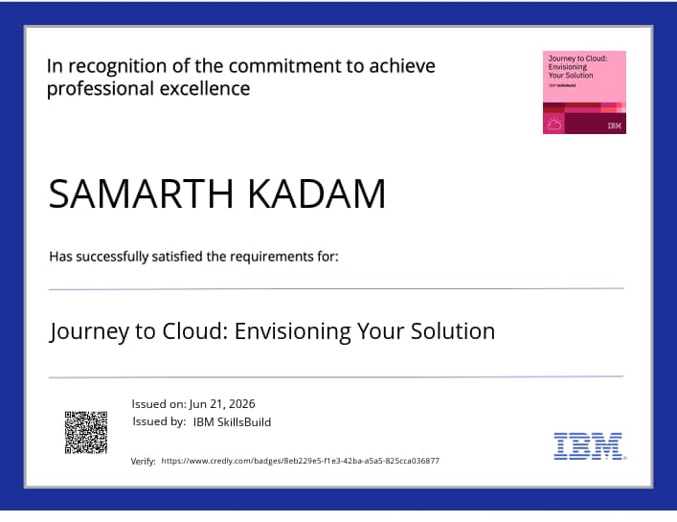
Certificates Earned:

Slide 17
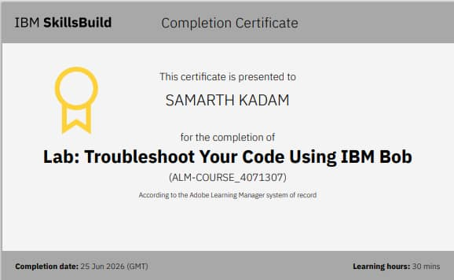
Certificates Earned:​

Slide 18
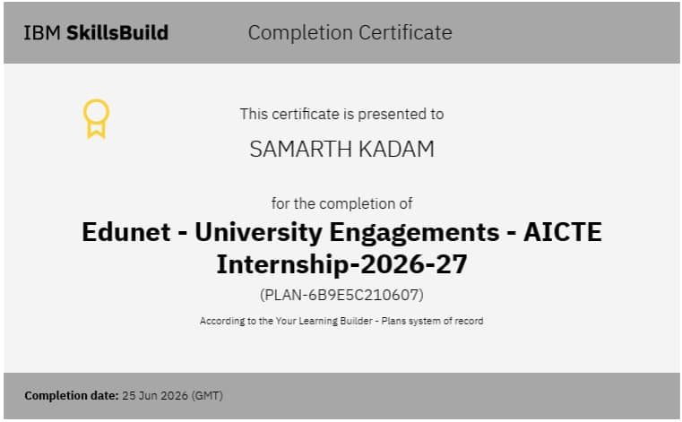
Certificates Earned:​

Slide 19
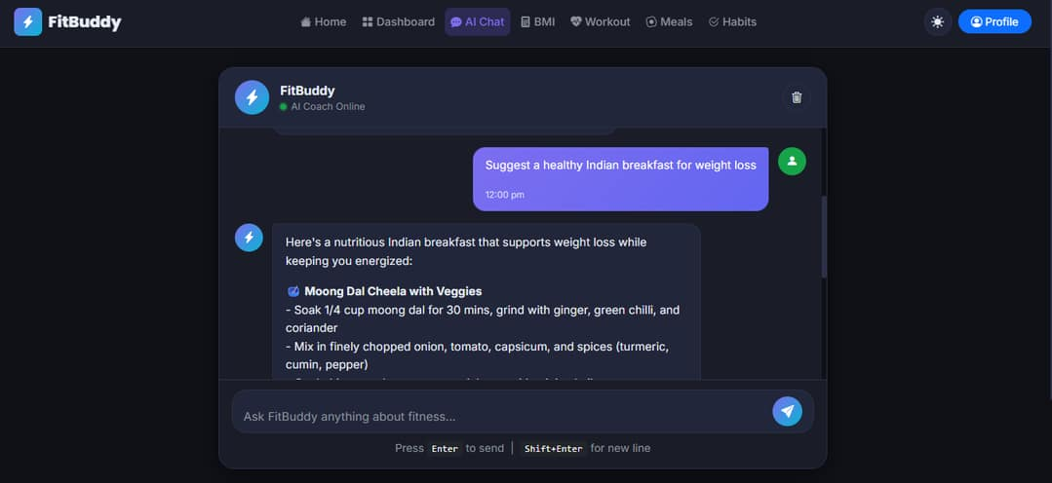
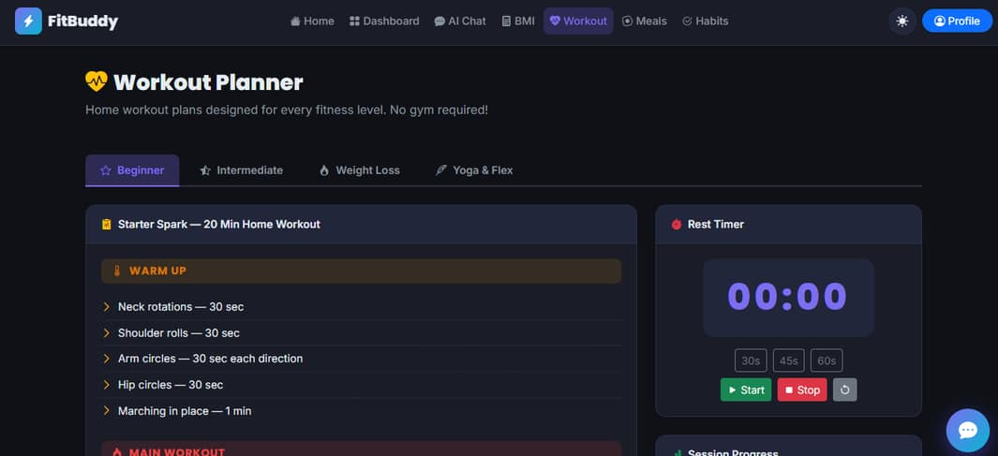
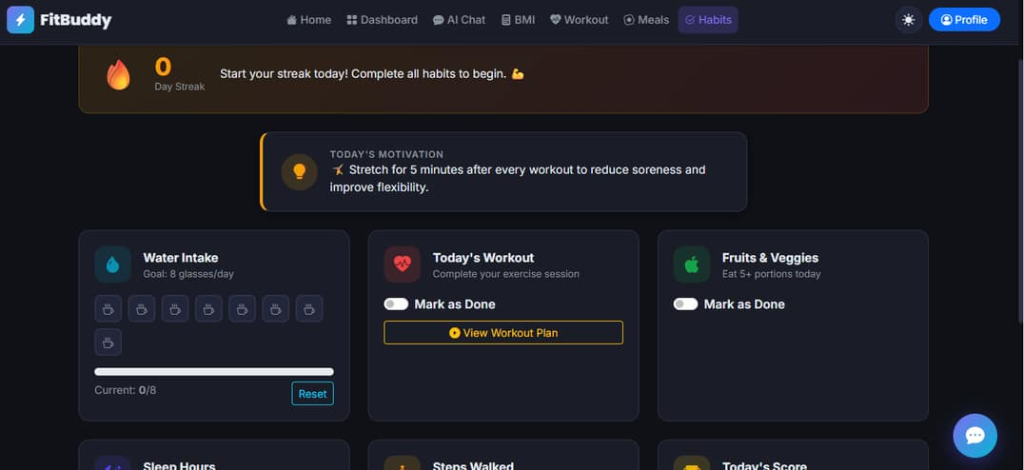
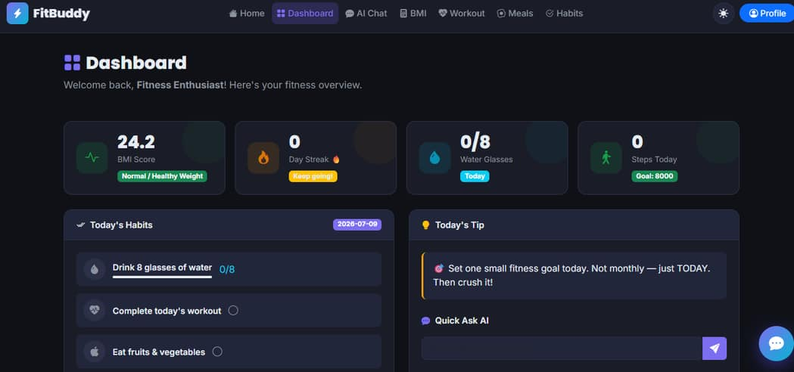
Images of project

Slide 20


